Slide 1


AI for Radio Access Network
Emilio Paolini, PhD Student Andrea Sgambelluri, Assistant Professor
Luca Valcarenghi, Professor

Slide 2
Outline
Set-up and Warm-up
Why Jupyter Notebooks
Basics of Artificial Intelligence algorithm
Exercise & Report

Slide 3
Set-up & Warm-up

Slide 4
Why Jupyter Notebooks 1/2
The "Notebook" term may refer both to the notebook document and the web-based environment used to create it.
It uses an internal library for converting the document in HTML and allows visualization and editing in the browser.

Slide 5
Why Jupyter Notebooks 2/2
The document we will use, with extension .ipynb, is a notebook and consists in an ordered list of cells which can contain code, text, mathematics, visualization of output and plots.
The key features of a Jupyter Notebook are the following:
it consists in executable Python code enriched with text-editing capabilities;
it allows interactive development: small pieces of code (cells) can be executed independently

Slide 6
Types of cells
A Jupyter Notebook document consists of a series of cells that can be executed individually. There are two main types of cells:
Code cells: contain executable code, allowing you to write and execute code in the chosen programming language, such as Python.
Markdown cells: These cells use Markdown syntax, which allows you to write formatted text, include images, create headings, lists, tables, and even mathematical equations using LaTeX syntax.

Slide 7
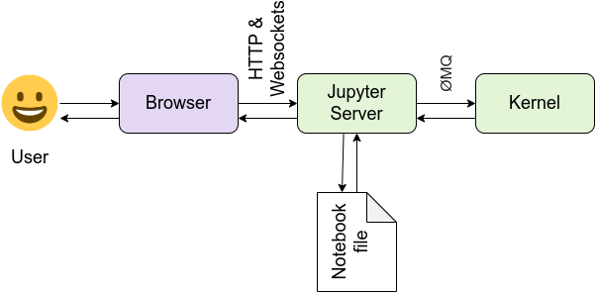
Notebook and IPython Kernel
The IPython kernel is the computational engine behind Jupyter Notebooks
Notebook frontend communicate with the IPython Kernel using JSON messages sent over the sockets provided by a messaging library named ZeroMQ.
Sockets are objects for sending and receiving data between local processes or in a computer network

Slide 8
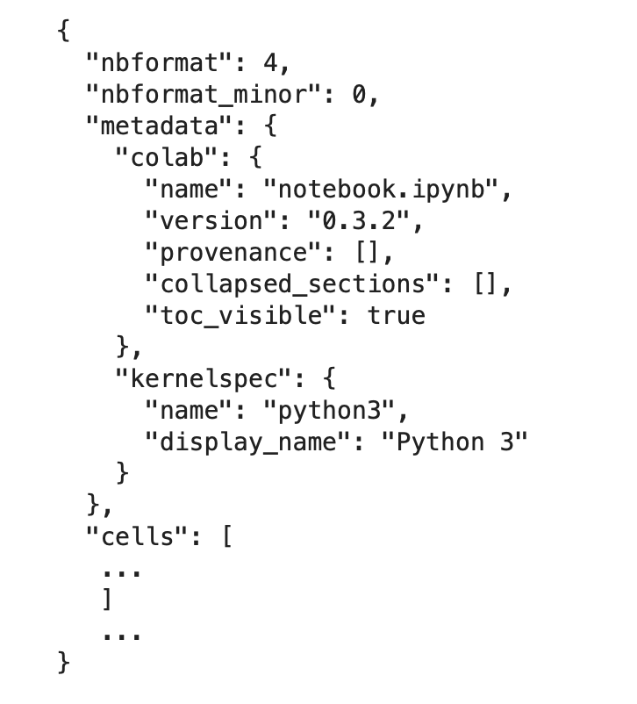
Notebook files
When you save the notebook, this is sent from your browser to the notebook server, which saves it on disk as a JSON file with a .ipynb extension.
The notebook server, not the kernel, is responsible for saving and loading notebooks, so you can edit notebooks even if you don’t have the kernel for that language—you just won’t be able to run code

Slide 9
Brief History

Slide 10
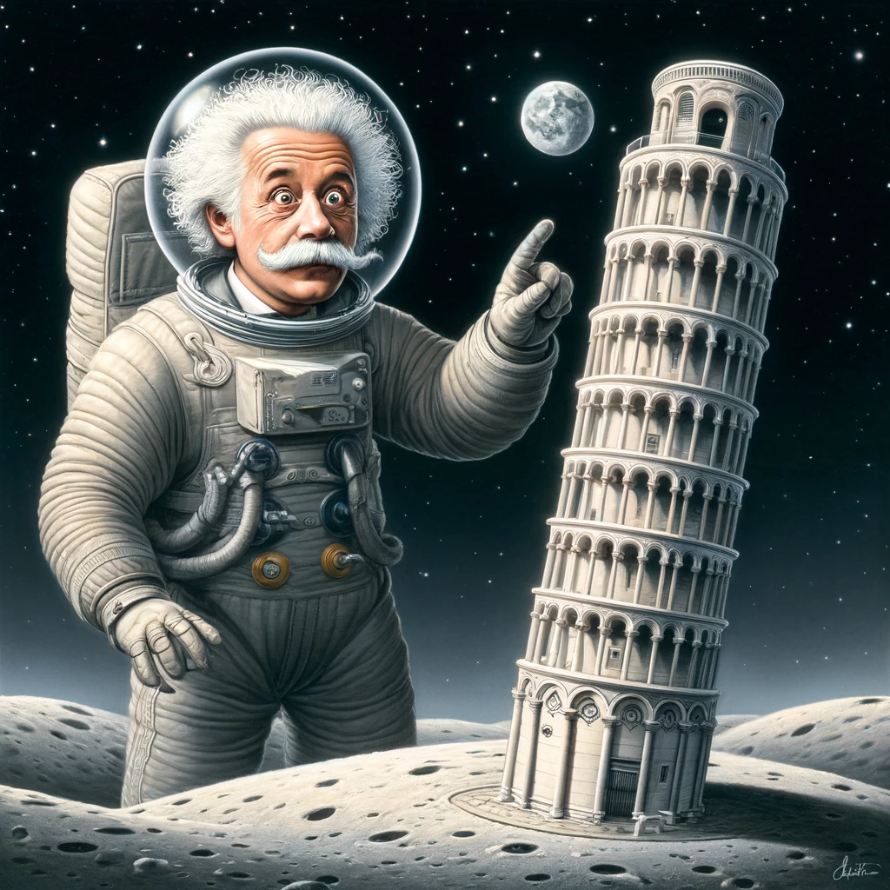
Introduction
1943 - Pitts and McCulloch created a computer model based on the neural networks of the human brain
1960s - Back-propagation model basics
1970s - AI winter: promises that couldn’t be kept
1980s - Convolution emerges, LeNet performs Digit Recognition
1988-90s - Second AI winter: the “immediate” potential of AI was exaggerated. AI = pseudoscience status
2000-2010 - Big data introduction, first big datasets (ImageNet)
2010-2020 - Computational power, generative model appears
Present - AI boom. AI is pervasive and influences the creation of new business models
Prompt: a spaceman Albert Einstein reaching the moon and finding the leaning tower of Pisa
Image generated with ChatGPT (DALL-E)

Slide 11
Deep Learning in the framework of AI
Artificial Intelligence
A system’s ability to correctly interpret external data, to learn from such data, and to use those learnings to achieve specific goals and tasks through flexible adaptation.
Machine Learning
The field of study that gives computers the ability to learn without being explicitly programmed.
Deep Learning
Class of machine learning algorithms that uses multiple layers to progressively extract higher level features from raw input
ARTIFICIAL INTELLIGENCE
MACHINE LEARNING
DEEP LEARNING

Slide 12
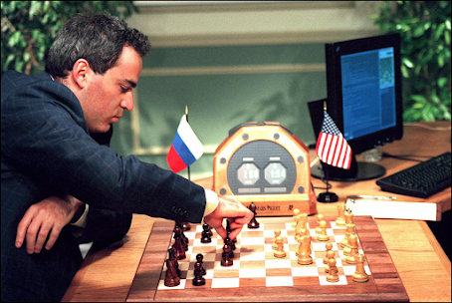
Good Old-Fashioned AI - GOFAI
Symbolic AI was the dominant paradigm until the late 1980s.
Main difference is where the learning happens: in GOFAI rules are created through human intervention (hard-coded).
IBM’s Deep Blue: the first time a chess-playing computer was able to beat a world champion.
Kasparov said he believed he was "the first worker whose job was threatened by a machine."

Slide 13
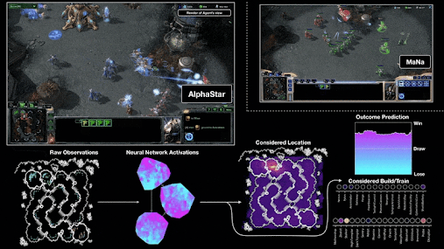
Reasoning
Every AI today is purpose-built and heavily trained to achieve that one (narrow) function.
AlphaStar: it uses Deep Neural Networks to learn how to play Starcraft II.
But, someone sat down and crafted the networks and reinforcement learning strategy that trained AlphaStar to learn how to play Starcraft II.
There is a large gap between what these systems are capable of currently and what is needed to build systems that can reason.

Slide 14


ChatGPT
ChatGPT 3.5 It has trained itself on 300 billion tokens (word fragments) using a huge amount of the internet and is able to code in several coding languages, write scientific papers and also discuss about ethics. Final size: 175 billion parameters, ~ 570 GB.
Estimated running cost: $700k/day.
ChatGPT 4
Able to process images, users can change the personality of the chatbot with a style and tone according to their own needs; six times larger than version 3.

Slide 15
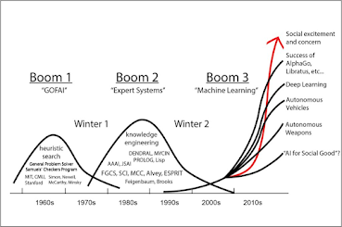



Factors that led to DL explosion
Since 2012 investment in AI has grow exponentially global startup funding:
$670 million in 2011
$36 billion U.S. dollars in 2020
$77 billion in 2021
AI systems have been around since the 1950s, so why are we suddenly seeing breakthroughs in so many diverse areas?
Three main factors:
Enormously increased data (5G, IoT)
Significantly improved algorithms and models
Higher computing power
Notes:
if we look at the investments in AI startups, we can observe an increasing trend. Indeed, we went from 670 millions of dollars in 2011 to 36 billion in 2020, that are more than double in 2021. Why do we have these huge investments in this period?
For mainly three factors:
- The great amount of data that we generate, thanks to iot and 5G
- Research in AI has developed better models and algorithms
- The increasing computational power that we have available

Slide 16
Introduction to AI

Slide 17
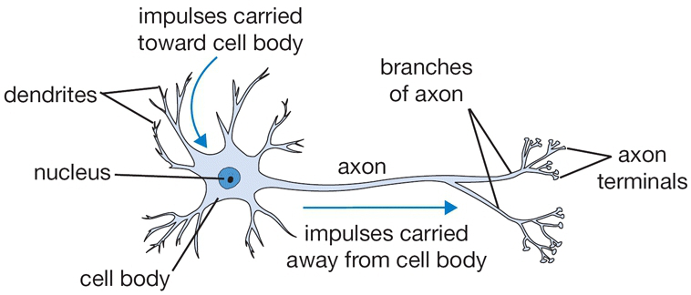
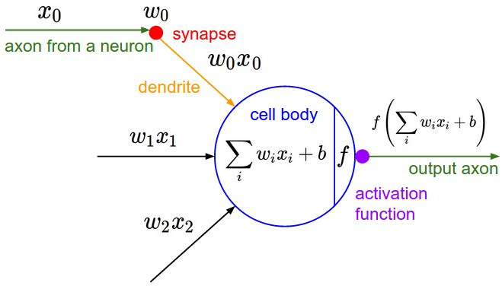
Biological Neuron vs Artificial Neuron
weighted sum

Slide 18
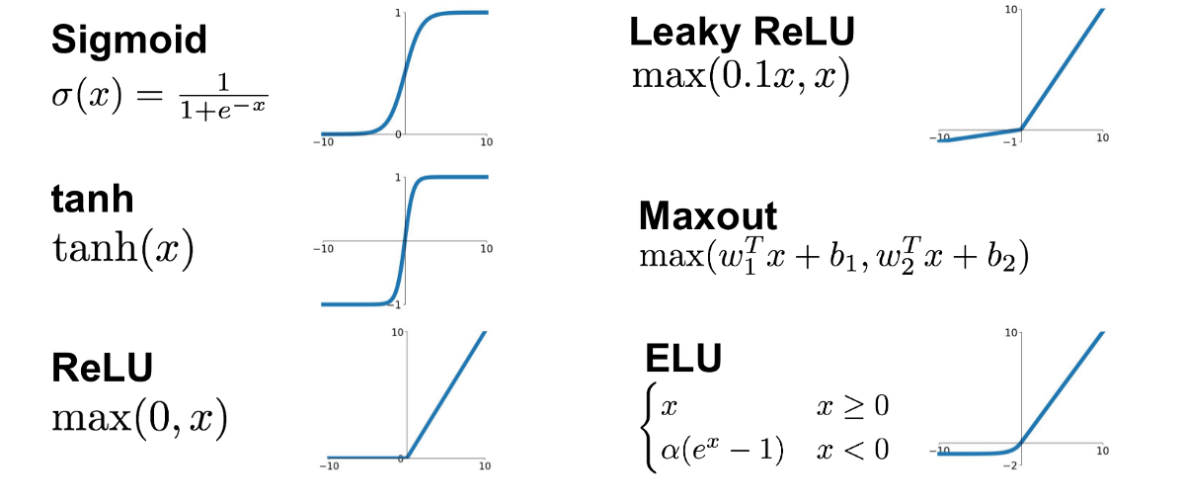
Activation functions (non-linearity)
A good activation function has several properties:
it is continuous and has an infinite domain, so to have an output number for any input;
it is monotonic. With a parabola, for example, we may have the same output value for two different input values;
it is non-linear: a NN with plenty of layers, but using only linear activation functions is equivalent to a NN with only one linear layer;
it should be efficiently computable.

Slide 19
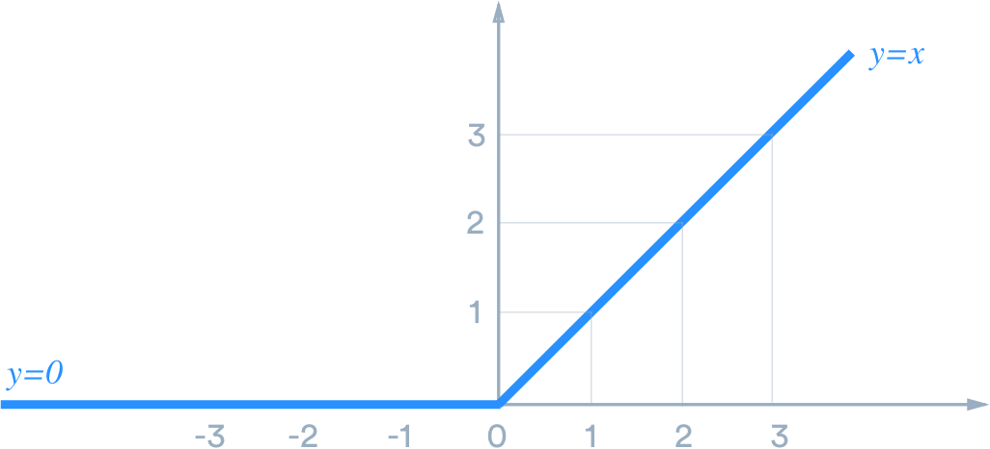
ReLU activation function
it does not require expensive computation, by only thresholding the activations at zero;
it allows a sparse representation that, in turn, guarantees
information disentangling: small changes of the input do not affect the features representation;
A drawback of these units is the fact that they do not learn when they have negative input
when too many units lie in this region, the effective capacity of the model could be dramatically reduced.

Slide 20
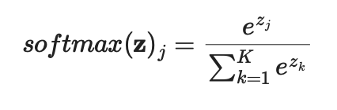
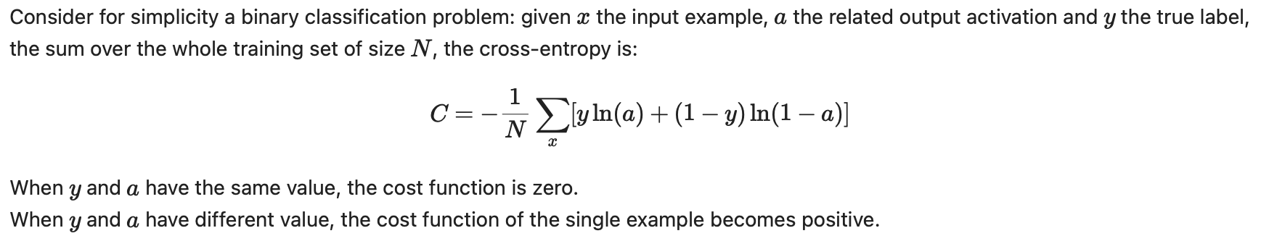
Basics 1/2
Output units
The desired distribution in the output layer guides the choice of the output units.
Loss Function
The learning procedure aims at minimizing the loss function. It is chosen in conjunction with the task and the output units.
Regression: Mean Squared Error loss (MSE)
Classification: Cross-Entropy (most common).

Slide 21
Basics 2/2
Forward propagation
During the forward step, the network accepts an input and computes the related output.
Backpropagation
Gradient descent algorithm requires that the gradient of the scalar cost is calculated with respect to the weights of the network.

Slide 22
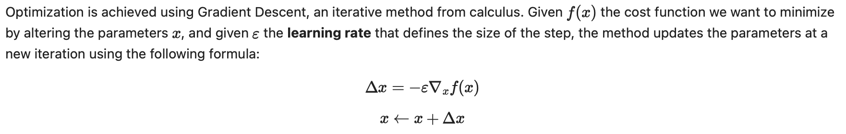
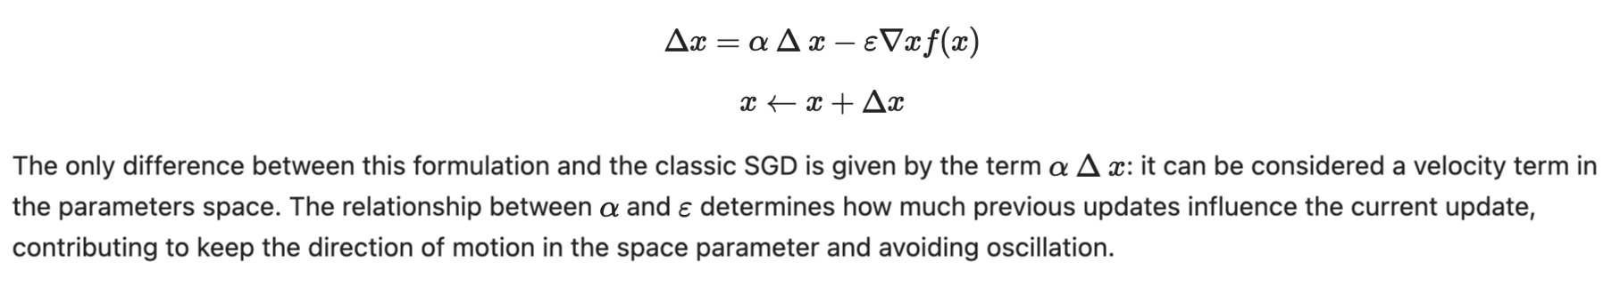
Gradient Based Learning
The optimization procedure aims to minimize a cost function by updating the weights in order to find a configuration that implements the desired function.
momentum: The optimization procedure aims to minimize a cost function by updating the weights in order to find a configuration that implements the desired function.

Slide 23
Model HyperParameters vs Parameters
Hyperparameters
Number of layers and hidden units: affects the capacity of the model;
Learning rate: determines the step size in learning procedure;
Learning rate decay strategy;
Mini-batch size;
Number of epochs of training and stop criterion;
Weights initialization strategy;
Preprocessing strategy;
and possibly many others
Parameters
weights and biases that define the behaviour of neurons and are adjusted by the training procedure

Slide 24
Model HyperParameters vs Parameters
How many hidden layers? How many units per layer? Which optimizer and learning rate value?

Slide 25
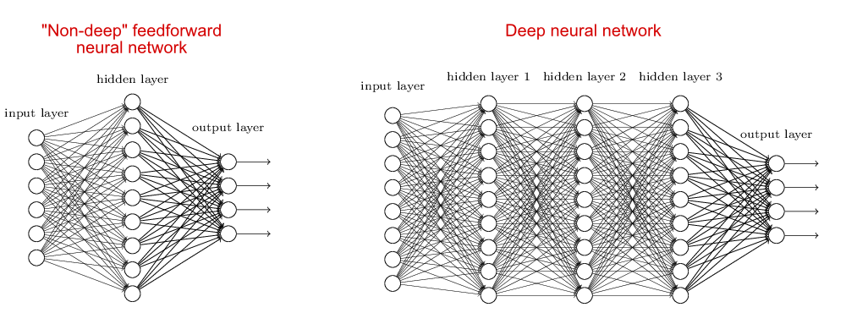
Non-deep vs Deep
“for a big enough neural network, it always exists a parameters configuration that makes the network able to approximate any continuous function defined on a compact set of the nth-dimensional vector space over the real numbers.”
However, it is not guaranteed that the training procedure will guide the model to that parameters configuration.

Slide 26
Overfitting
Overfitting is a concept in machine learning and statistics where a model learns to perform extremely well on the training data but fails to generalize well to new, unseen data. How to prevent it?
Getting more training data
Performing dataset augmentation
Reducing the capacity of the network
Adding weight regularization
Adding dropout
The idea behind dropout: "I went to my bank. The tellers kept changing and I asked one of them why. He said he didn’t know but they got moved around a lot. I figured it must be because it would require cooperation between employees to successfully defraud the bank. This made me realize that randomly removing a different subset of neurons on each example would prevent conspiracies and thus reduce overfitting."

